Slide 1
Domain ML
Technology: Python
PHISHING WEBSITE DETECTION USING MACHINE LEARNING

Slide 2
ABSTRACT
Phishing websites are a serious threat to online security, as they attempt to steal sensitive information from unsuspecting users. To combat this threat, researchers have developed various techniques for detecting phishing websites, including machine learning algorithms. Machine learning algorithms can be trained on large datasets of phishing and legitimate websites to learn patterns and characteristics that distinguish between the two. These algorithms can then be used to identify and block phishing websites before users can be victimized. One approach to phishing website detection using machine learning involves feature extraction, where various features of a website such as URL structure, domain age, and content are analyzed to identify phishing websites. Another approach involves using deep learning algorithms to automatically extract features and learn complex patterns in website data. Overall, machine learning-based phishing website detection techniques have shown promising results, achieving high accuracy rates and outperforming traditional rule-based methods. With further research and development, these techniques have the potential to become an important tool in the fight against online phishing attacks.
Keywords: Machine learning techniques, Xgboost, Gradient boosting, Adaboost, SVM, Random forest, evaluation.

Slide 3
INTRODUCTION
Phishing website detection is the process of identifying and flagging websites that attempt to impersonate legitimate websites with the goal of stealing sensitive information such as login credentials, credit card numbers, and personal identification information . Phishing attacks have become increasingly sophisticated over the years, and attackers often use tactics such as social engineering and fake login screens to trick users into giving up their sensitive information. Phishing websites may also use URL spoofing to make it appear that the user is on a legitimate. Phishing attacks are a common type of cybercrime that involves the use of fraudulent emails, messages, or websites to trick users into revealing sensitive information. One of the most effective ways to combat phishing attacks is through the detection and blocking of phishing websites. Phishing website detection involves the use of various techniques and technologies to identify and flag websites that are designed to deceive users. One common technique used by attackers is to create websites that closely mimic the appearance of legitimate sites, such as banks or e-commerce sites. These phishing sites are often hosted on compromised servers or using domain names that are similar to the real sites.

Slide 4
One approach to detecting phishing websites is to use machine learning algorithms that can analyze website content, metadata, and other features to identify potential phishing sites. These algorithms can be trained on large datasets of known phishing websites to identify common patterns and characteristics. Some machine learning models may also incorporate real-time data feeds to identify and flag new phishing sites as they are created. Another approach to phishing website detection is to use reputation-based systems that maintain lists of known malicious websites. These systems can use various sources of information, such as blacklists, user reports, and threat intelligence feeds to identify and block phishing sites. Some web browsers also use reputation-based systems to warn users when they attempt to access a known phishing site. Phishing website detection may also involve the use of behavioral analysis techniques that can detect unusual or suspicious activity on a website. For example, these techniques may look for patterns of user behavior that differ from normal usage, such as a sudden increase in requests for login credentials or an unusual number of redirects to other sites. Overall, the detection and blocking of phishing websites is an essential component of any effective cybersecurity strategy. By using a combination of machine learning algorithms, reputation-based systems, and behavioral analysis techniques, organizations can protect their users and prevent sensitive information from falling into the hands of attackers.Therefore, it is crucial to remain vigilant and stay up-to-date with the latest phishing threat trends and detection methods.

Slide 5
LITERATURE SURVEY
J. Shad and S. Sharma, “A Novel Machine Learning Approach to Detect Phishing Websites Jaypee Institute of Information Technology’’.
In the last few years, many fake websites have developed on the World Wide Web to harm users by stealing their confidential information such as account ID, user name, password, etc. Phishing is the social engineering attacks and currently attacks on mobile devices. That might result in the form of financial loses. In this paper, we described many detection techniques using URL, Hyperlinks features that can be used to differentiate between the defective and non-defective website. There are six main approaches such as heuristic, blacklist, Fuzzy Rule, machine learning, image processing, and CANTINA based approach. It delivers a good consideration of the phishing issue, a present machine learning solution, and future study about Phishing threats by using machine learning Approach.

Slide 6
2. Y. Sönmez, T. Tuncer, H. Gökal, and E. Avci, “Phishing web sites features classification based on extreme learning machine,” 6th Int. Symp. Digit. Forensic Secur. ISDFS - Proceeding.
Phishing is a common attack on credulous people by making them to disclose their unique information using counterfeit websites. The objective of phishing website URLs is to purloin the personal information like user name, passwords and online banking transactions. Phishers use the websites which are visually and semantically similar to those real websites. As technology continues to grow, phishing techniques started to progress rapidly and this needs to be prevented by using anti-phishing mechanisms to detect phishing. Machine learning is a powerful tool used to strive against phishing attacks. This paper surveys the features used for detection and detection techniques using machine learning.

Slide 7
3. T. Peng, I. Harris, and Y. Sawa, “Detecting Phishing Attacks Using Natural Language Processing and Machine Learning,” Proc. - 12th IEEE Int. Conf. Semant. Comput.
Phishing attacks are one of the most common and least defended security threats today. We present an approach which uses natural language processing techniques to analyse text and detect inappropriate statements which are indicative of phishing attacks. Our approach is novel compared to previous work because it focuses on the natural language text contained in the attack, performing semantic analysis of the text to detect malicious intent. To demonstrate the effectiveness of our approach, we have evaluated it using a large benchmark set of phishing emails. The prescient model comprises of Feature Selection Module which is utilized for the development of a successful element vector. These highlights are removed from the URL,

Slide 8
4. M. Karabatak and T. Mustafa, “Performance comparison of classifiers on reduced phishing website dataset,” 6th Int. Symp. Digit. Forensic Secur. ISDFS - Proceeding.
These days, numerous enemy of phishing frameworks are being created to recognize phishing substance in online correspondence frameworks. In spite of the accessibility of hordes hostile to phishing frameworks, phishing proceeds with unabated because of lacking recognition of a zero-day assault, pointless computational overhead and high bogus rates. In spite of the fact that Machine Learning approaches have accomplished promising exactness rate, the decision and the exhibition of the component vector limit their successful location. Phishing is a typical assault on guileless individuals by making them to unveil their one of a kind data utilizing fake sites. In this work, an upgraded AI based prescient model is proposed to improve the effectiveness of against phishing plans. Website page properties and site page conduct utilizing the gradual segment-based framework to introduce the resultant component vector to the prescient model. The proposed framework utilizes CNN, KNN AND SVM which have been prepared on a 30-dimensional list of capabilities. AI is an incredible asset used to endeavor against phishing assaults

Slide 9
5. K. Shima et al., “Classification of URL bitstreams using bag of bytes,” in 21st Conference on Innovation in Clouds, Internet and Networks and Workshops (ICIN).
In present days ,websites are main responsible for the rapid growth of criminal activities in the internet and corresponding activities which results in the many illegal things. So there are many preventive steps to be taken to stop these kind of activities. Here we propose a model which will classify the given URL into any of the three possible classes ,.i.e. Benign, spam and malware. Our model will the detect the classification of the URL without using any websites content. Phishing is the social engineering attacks and currently attacks on mobile devices. That might result in the form of financial loses. Phishers use the websites which are visually and semantically similar to those real websites.

Slide 10
EXISTING SYSTEM:
Existing systems for phishing website detection using machine learning often rely on supervised learning techniques that require labeled data for training. This means that a large dataset of both legitimate and phishing websites must be manually labeled, which can be time-consuming and costly.
DISADVANTAGES:
Disadvantage is that these systems may be vulnerable to adversarial attacks, where attackers can manipulate the website features to evade detection. Additionally, machine learning-based systems may require significant computational resources, which could limit their scalability.
Finally, these systems may produce false positives or false negatives, which can impact the user experience and reduce the effectiveness of the system. These limitations highlight the need for ongoing research and development in the field of machine learning-based phishing website detection.

Slide 11
PROPOSED SYSTEM:
The proposed system for phishing website detection using machine learning algorithms aims to overcome the limitations of existing systems. One approach is to use supervised learning techniques that do not require labelled data for training. This can reduce the time and cost of data labelling and improve scalability.
Another approach is to incorporate multiple machine learning algorithms to enhance the accuracy and robustness of the system. The system can also be augmented with additional features such as website behaviour analysis and user behaviour monitoring to improve its ability to detect phishing websites.
Overall, the proposed system aims to improve the accuracy, efficiency, and effectiveness of phishing website detection using machine learning algorithms.

Slide 12
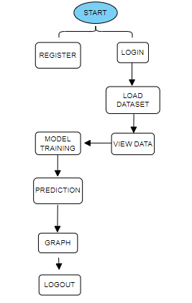
BLOCK DIAGRAM

Slide 13
MODULES:
User:
Registration page:
Here user needs to register with his/her details.
Login Page:
Here user needs to login with credentials.
View Home page:
Here user view the home page of the phishing website prediction web application.
View Upload page:
In the about page, users can learn more about the phishing prediction.
View Page:
In view page, user can see the dataset.
Input Model:
The user must provide input values for the certain fields in order to get results.
View Results:
User view’s the generated results from the model.
View score:
Here user have ability to view the score in %

Slide 14
System
Working on dataset:
System checks for data whether it is available or not and load the data in csv files.
Pre-processing:
Data need to be pre-processed according the models it helps to increase the accuracy of the model and better information about the data.
Training the data:
After pre-processing the data will split into two parts as train and test data before training with the given algorithms.
Model Building
To create a model that predicts the personality with better accuracy, this module will help user.
Generated Score:
Here user view the score in %
Generate Results:
We train the machine learning algorithm and calculate the url’s prediction.

Slide 15
HARDWARE AND SOFTWARE REQUIREMENTS
H/W Configuration:
Operating system : Windows 7 or 7+
RAM : 8 GB
Hard disc or SSD : More than 500 GB
Processor : Intel 3rd generation or high or Ryzen with 8 GB Ram
S/W Configuration:
Software’s : Python 3.6 or high version
IDE : PyCharm.
Framework : Flask

Slide 16
ALGORITHMS
RANDOM FOREST CLASSIFIER:
A random forest is a machine learning technique that’s used to solve regression and classification problems. It utilizes ensemble learning, which is a technique that combines many classifiers to provide solutions to complex problems.
A random forest algorithm consists of many decision trees. The ‘forest’ generated by the random forest algorithm is trained through bagging or bootstrap aggregating. Bagging is an ensemble meta-algorithm that improves the accuracy of machine learning algorithms.
The (random forest) algorithm establishes the outcome based on the predictions of the decision trees. It predicts by taking the average or mean of the output from various trees. Increasing the number of trees increases the precision of the outcome.
A random forest eradicates the limitations of a decision tree algorithm. It reduces the over fitting of datasets and increases precision. It generates predictions without requiring many configurations in packages (like Scikit-learn).

Slide 17
Features of a Random Forest Algorithm:
It’s more accurate than the decision tree algorithm.
It provides an effective way of handling missing data.
It can produce a reasonable prediction without hyper-parameter tuning.
It solves the issue of over fitting in decision trees.
In every random forest tree, a subset of features is selected randomly at the node’s splitting point.
Decision trees are the building blocks of a random forest algorithm. A decision tree is a decision support technique that forms a tree-like structure. An overview of decision trees will help us understand how random forest algorithms work.
A decision tree consists of three components: decision nodes, leaf nodes, and a root node. A decision tree algorithm divides a training dataset into branches, which further segregate into other branches. This sequence continues until a leaf node is attained. The leaf node cannot be segregated further.
The nodes in the decision tree represent attributes that are used for predicting the outcome. Decision nodes provide a link to the leaves. The following diagram shows the three types of nodes in a decision tree.

Slide 18
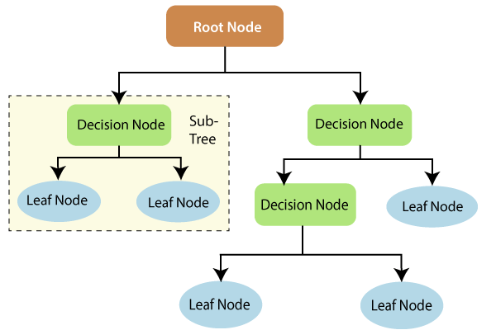
The information theory can provide more information on how decision trees work. Entropy and information gain are the building blocks of decision trees. An overview of these fundamental concepts will improve our understanding of how decision trees are built.
Entropy is a metric for calculating uncertainty. Information gain is a measure of how uncertainty in the target variable is reduced, given a set of independent variables.
The information gain concept involves using independent variables (features) to gain information about a target variable (class). The entropy of the target variable (Y) and the conditional entropy of Y (given X) are used to estimate the information gain. In this case, the conditional entropy is subtracted from the entropy of Y.

Slide 19
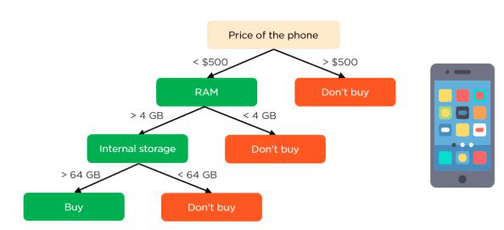
Information gain is used in the training of decision trees. It helps in reducing uncertainty in these trees. A high information gain means that a high degree of uncertainty (information entropy) has been removed. Entropy and information gain are important in splitting branches, which is an important activity in the construction of decision trees.
Let’s take a simple example of how a decision tree works. Suppose we want to predict if a customer will purchase a mobile phone or not. The features of the phone form the basis of his decision. This analysis can be presented in a decision tree diagram.
The root node and decision nodes of the decision represent the features of the phone mentioned above. The leaf node represents the final output, either buying or not buying. The main features

Slide 20

Support Vector Machine:
Support Vector Machine or SVM is one of the most popular Supervised Learning algorithms, which is used for Classification as well as Regression problems. However, primarily, it is used for Classification problems in Machine Learning. The goal of the SVM algorithm is to create the best line or decision boundary that can segregate n-dimensional space into classes so that we can easily put the new data point in the correct category in the future. This best decision boundary is called a hyperplane. SVM chooses the extreme points/vectors that help in creating the hyperplane. These extreme cases are called as support vectors, and hence algorithm is termed as Support Vector Machine. Consider the below diagram in which there are two different categories that are classified using a decision boundary or hyperplane:

Slide 21
SVM can be of two types:
Linear SVM: Linear SVM is used for linearly separable data, which means if a dataset can be classified into two classes by using a single straight line, then such data is termed as linearly separable data, and classifier is used called as Linear SVM classifier.
Non-linear SVM: Non-Linear SVM is used for non-linearly separated data, which means if a dataset cannot be classified by using a straight line, then such data is termed as non-linear data and classifier used is called as Non-linear SVM classifier.
Hyperplane and Support Vectors in the SVM algorithm:
Hyperplane:
There can be multiple lines/decision boundaries to segregate the classes in n-dimensional space, but we need to find out the best decision boundary that helps to classify the data points. This best boundary is known as the hyperplane of SVM.
The dimensions of the hyperplane depend on the features present in the dataset, which means if there are 2 features (as shown in image), then hyperplane will be a straight line. And if there are 3 features, then hyperplane will be a 2-dimension plane.

Slide 22
The dimensions of the hyperplane depend on the features present in the dataset, which means if there are 2 features (as shown in image), then hyperplane will be a straight line. And if there are 3 features, then hyperplane will be a 2-dimension plane.
We always create a hyperplane that has a maximum margin, which means the maximum distance between the data points.
Support Vectors:
The data points or vectors that are the closest to the hyperplane and which affect the position of the hyperplane are termed as Support Vector. Since these vectors support the hyperplane, hence called a Support vector

Slide 23
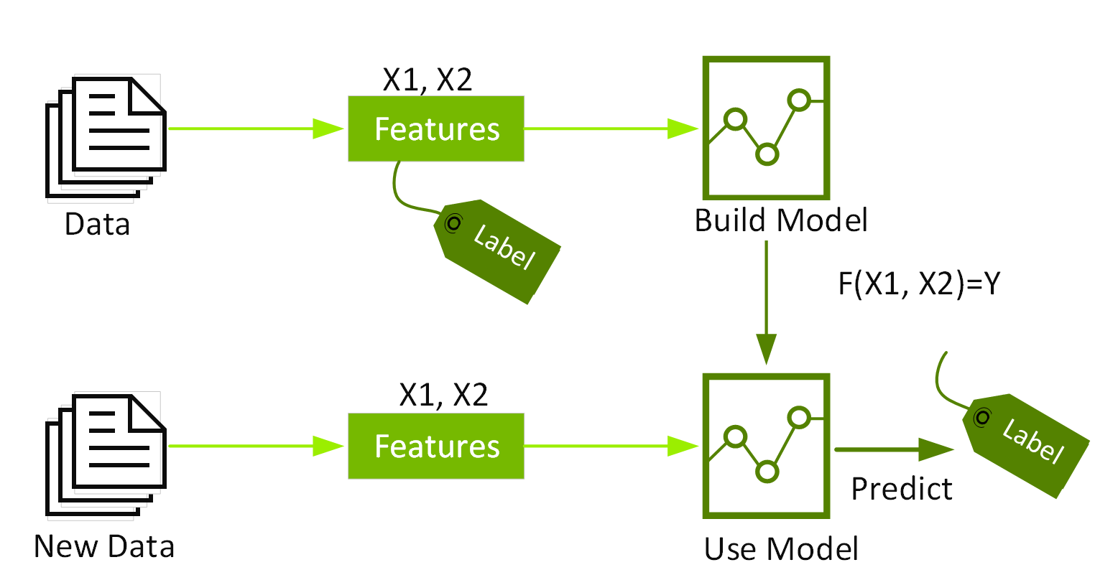
XGBoost:
Extreme Gradient Boosting (XGBoost) is a scalable, distributed gradient-boosted decision tree (GBDT) machine learning framework. It is the top machine learning package for regression, classification, and ranking tasks, and it supports parallel tree boosting.To understand XGBoost, you must first understand the machine learning ideas and methods on which it is based: supervised machine learning, decision trees, ensemble learning, and gradient boosting.Supervised machine learning use algorithms to train a model to detect patterns in a dataset containing labels and features, and then employs the trained model to predict the labels on the features of a new dataset.

Slide 24
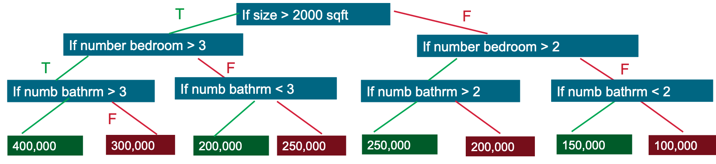
By evaluating a tree of if-then-else true/false feature questions and estimating the minimum number of questions required to assess the probability of making a correct decision, decision trees generate a model that predicts the label. Decision trees can be used to predict a category or a continuous numeric value using classification or regression. A decision tree is used in the basic example below to predict a property price (the label) based on the size and number of bedrooms (the features).
Gradient Boosting Decision Trees (GBDT) is a decision tree ensemble learning algorithm for classification and regression that is similar to random forest. To create a better model, ensemble learning techniques mix different machine learning methods.Both random forest and GBDT construct a model from multiple decision trees. The distinction is in how the trees are constructed and joined.

Slide 25
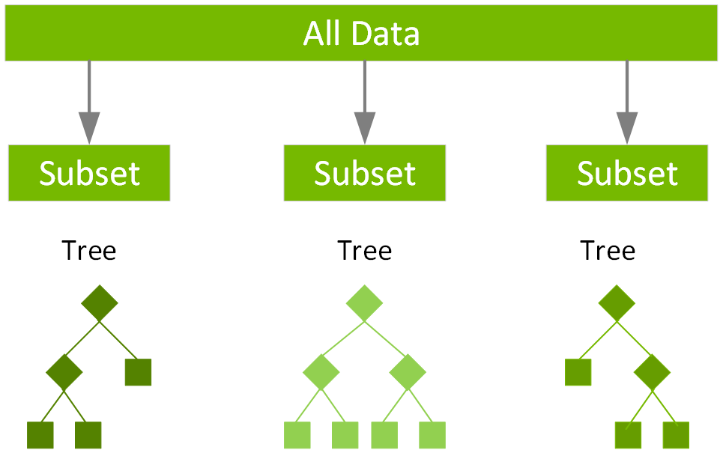
Random forest uses a technique called bagging to build full decision trees in parallel from random bootstrap samples of the data set. The final prediction is an average of all of the decision tree predictions.

Slide 26
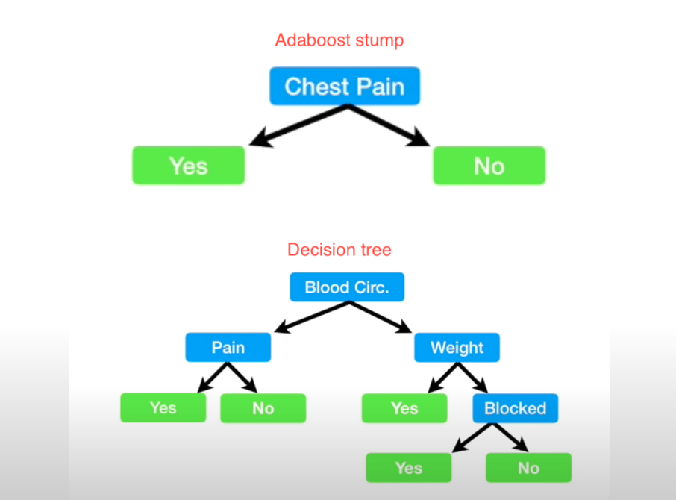
4.AdaBoost Algorithm:
AdaBoost also called Adaptive Boosting is a technique in Machine Learning used as an Ensemble Method. The most common algorithm used with AdaBoost is decision trees with one level that means with Decision trees with only 1 split. These trees are also called Decision Stumps.

Slide 27
AdaBoost algorithm, short for Adaptive Boosting, is a Boosting technique used as an Ensemble Method in Machine Learning. It is called Adaptive Boosting as the weights are re-assigned to each instance, with higher weights assigned to incorrectly classified instances. Boosting is used to reduce bias as well as variance for supervised learning. It works on the principle of learners growing sequentially. Except for the first, each subsequent learner is grown from previously grown learners. In simple words, weak learners are converted into strong ones. The AdaBoost algorithm works on the same principle as boosting with a slight difference. Let’s discuss this difference in detail.
Let us discuss how boosting works. It makes ‘n’ number of decision trees during the data training period. As the first decision tree/model is made, the incorrectly classified record in the first model is given priority. Only these records are sent as input for the second model. The process goes on until we specify a number of base learners we want to create. Remember, repetition of records is allowed with all boosting techniques. These data science challenges give a global forum for learning, researching, and solving corporate and government problems. Boosting algorithms combine many low accuracy (weak) models to produce high accuracy (strong) models. It may be used in a variety of fields, including credit, insurance, marketing, and sales. Machine learning techniques such as AdaBoost, Gradient Boosting, and XGBoost are extensively utilized to win data science contests. In this course, you will learn about the AdaBoost ensemble boosting method.

Slide 28
Gradient boosting:
Gradient boosting algorithm is one of the most powerful algorithms in the field of machine learning. As we know that the errors in machine learning algorithms are broadly classified into two categories i.e. Bias Error and Variance Error. As gradient boosting is one of the boosting algorithms it is used to minimize bias error of the model.
Unlike, Adaboosting algorithm, the base estimator in the gradient boosting algorithm cannot be mentioned by us. The base estimator for the Gradient Boost algorithm is fixed and i.e. Decision Stump. Like, AdaBoost, we can tune the n_estimator of the gradient boosting algorithm. However, if we do not mention the value of n_estimator, the default value of n_estimator for this algorithm is 100.

Slide 29
Gradient boosting algorithm can be used for predicting not only continuous target variable (as a Regressor) but also categorical target variable (as a Classifier). When it is used as a regressor, the cost function is Mean Square Error (MSE) and when it is used as a classifier then the cost function is Log loss.
Let us now understand the working of the Gradient Boosting Algorithm with the help of one example. In the following example, Age is the Target variable whereas LikesExercising, GotoGym, DrivesCar are independent variables. As in this example, the target variable is continuous, GradientBoostingRegressor is used here.
Let us now find out the estimator-2. Unlike AdaBoost, in the Gradient boosting algorithm, residues (agei – mu) of the first estimator are taken as root nodes as shown below. Let us suppose for this estimator another dependent variable is used for prediction. So, the records with False GotoGym.

Slide 30
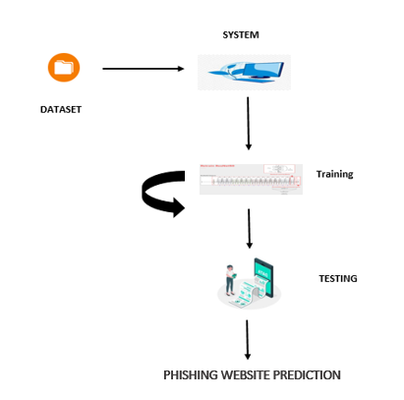
ARCHITECTURE:

Slide 31
UML DIAGRAMS
UML stands for Unified Modelling Language. UML is a standardized general-purpose modelling language in the field of object-oriented software engineering. The standard is managed, and was created by, the Object Management Group.
The goal is for UML to become a common language for creating models of object-oriented computer software. In its current form UML is comprised of two major components: a Meta-model and a notation. In the future, some form of method or process may also be added to; or associated with, UML.
The Unified Modelling Language is a standard language for specifying, Visualization, Constructing and documenting the artefacts of software system, as well as for business modelling and other non-software systems. The UML represents a collection of best engineering practices that have proven successful in the modelling of large and complex systems.
The UML is a very important part of developing objects-oriented software and the software development process. The UML uses mostly graphical notations to express the design of software projects.

Slide 32
GOALS:
The Primary goals in the design of the UML are as follows:
Provide users a ready-to-use, expressive visual modelling Language so that they can develop and exchange meaningful models.
Provide extendibility and specialization mechanisms to extend the core concepts.
Be independent of particular programming languages and development process.
Provide a formal basis for understanding the modelling language.
Encourage the growth of OO tools market.
Support higher level development concepts such as collaborations, frameworks, patterns and components.
Integrate best practices.

Slide 33
USE CASE DIAGRAM
A use case diagram in the Unified Modeling Language (UML) is a type of behavioral diagram defined by and created from a Use-case analysis.
Its purpose is to present a graphical overview of the functionality provided by a system in terms of actors, their goals (represented as use cases), and any dependencies between those use cases.
The main purpose of a use case diagram is to show what system functions are performed for which actor. Roles of the actors in the system can be depicted.

Slide 34
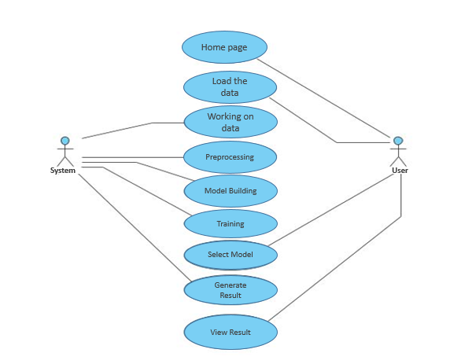

Slide 35
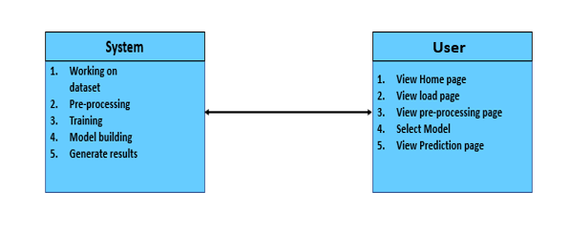
CLASS DIAGRAM
In software engineering, a class diagram in the Unified Modeling Language (UML) is a type of static structure diagram that describes the structure of a system by showing the system's classes, their attributes, operations (or methods), and the relationships among the classes. It explains which class contains information

Slide 36
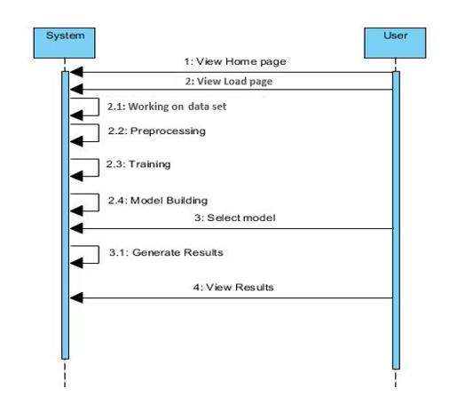
SEQUENCE DIAGRAM
A sequence diagram in Unified Modeling Language (UML) is a kind of interaction diagram that shows how processes operate with one another and in what order.
It is a construct of a Message Sequence Chart. Sequence diagrams are sometimes called event diagrams, event scenarios, and timing diagrams

Slide 37
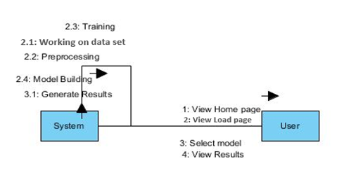
COLLABORATION DIAGRAM:
In collaboration diagram the method call sequence is indicated by some numbering technique as shown below. The number indicates how the methods are called one after another. We have taken the same order management system to describe the collaboration diagram. The method calls are similar to that of a sequence diagram. But the difference is that the sequence diagram does not describe the object organization whereas the collaboration diagram shows the object organization.

Slide 38
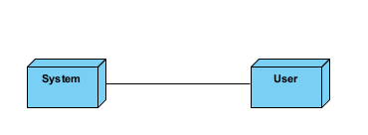
DEPLOYMENT DIAGRAM
Deployment diagram represents the deployment view of a system. It is related to the component diagram. Because the components are deployed using the deployment diagrams. A deployment diagram consists of nodes. Nodes are nothing but physical hardware’s used to deploy the application.

Slide 39
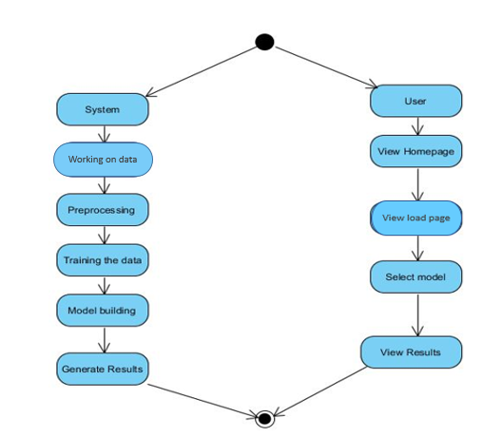
ACTIVITY DIAGRAM:
Activity diagrams are graphical representations of workflows of stepwise activities and actions with support for choice, iteration and concurrency. In the Unified Modelling Language, activity diagrams can be used to describe the business and operational step-by-step workflows of components in a system. An activity diagram shows the overall flow of control.

Slide 40
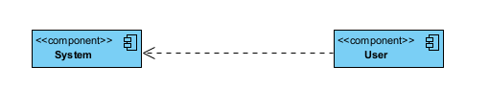
COMPONENT DIAGRAM:
A component diagram, also known as a UML component diagram, describes the organization and wiring of the physical components in a system. Component diagrams are often drawn to help model implementation details and double-check that every aspect of the system's required function is covered by planned development.

Slide 41
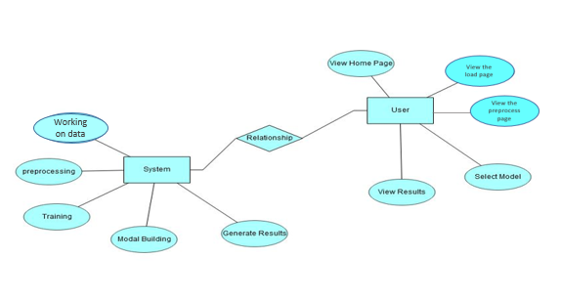
ER DIAGRAM:
An Entity–relationship model (ER model) describes the structure of a database with the help of a diagram, which is known as Entity Relationship Diagram (ER Diagram). An ER model is a design or blueprint of a database that can later be implemented as a database. The main components of E-R model are: entity set and relationship set.
An ER diagram shows the relationship among entity sets. An entity set is a group of similar entities and these entities can have attributes. In terms of DBMS, an entity is a table or attribute of a table in database, so by showing relationship among tables and their attributes, ER diagram shows the complete logical structure of a database. Let’s have a look at a simple ER diagram to understand this concept.

Slide 42
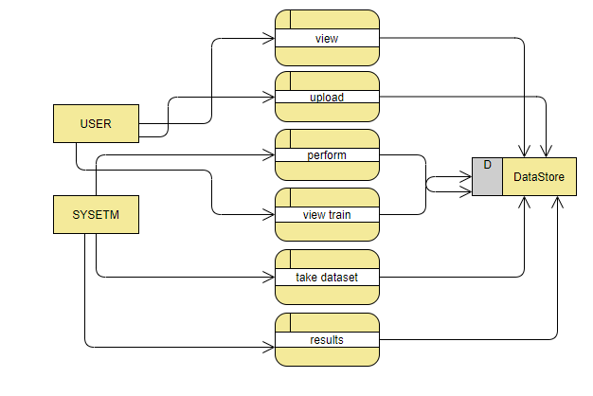
DFD DIAGRAM:
A Data Flow Diagram (DFD) is a traditional way to visualize the information flows within a system. A neat and clear DFD can depict a good amount of the system requirements graphically. It can be manual, automated, or a combination of both. It shows how information enters and leaves the system, what changes the information and where information is stored. The purpose of a DFD is to show the scope and boundaries of a system as a whole. It may be used as a communications tool between a systems analyst and any person who plays a part in the system that acts as the starting point for redesigning a system.

Slide 43
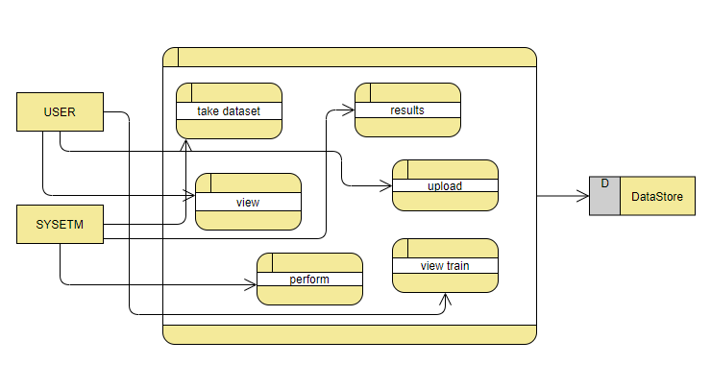

Slide 44

OUTPUT SCREEN SHOTS WITH DESCRIPTION.
Home Page:
Here user view the home page of phishing website prediction web application.

Slide 45

Load:
In the load page, users can load the website dataset.

Slide 46
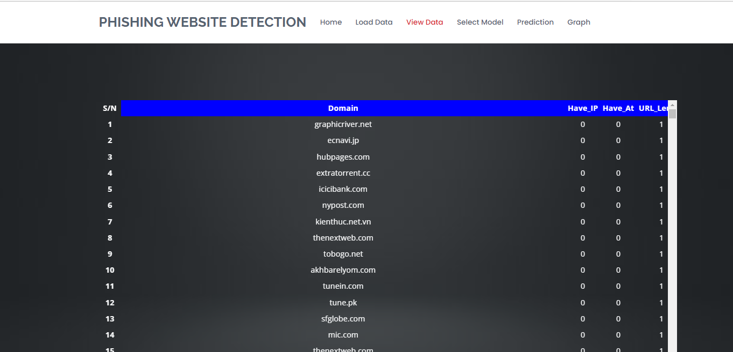
View:
Here we can see the uploaded data set.

Slide 47
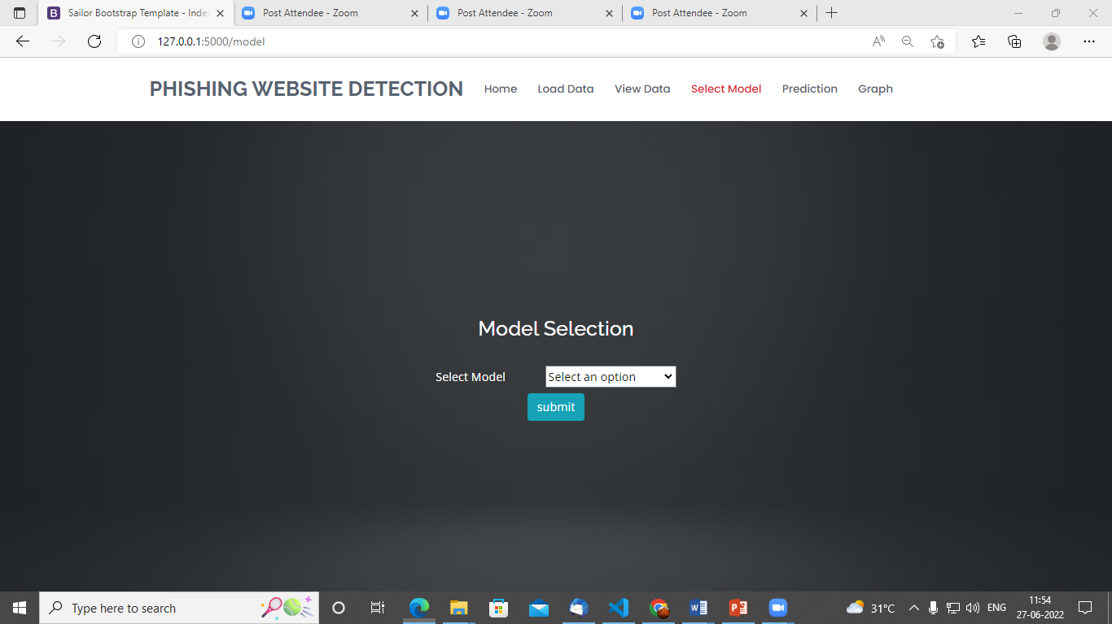
Model:
Here we can train our data using different algorithm.

Slide 48
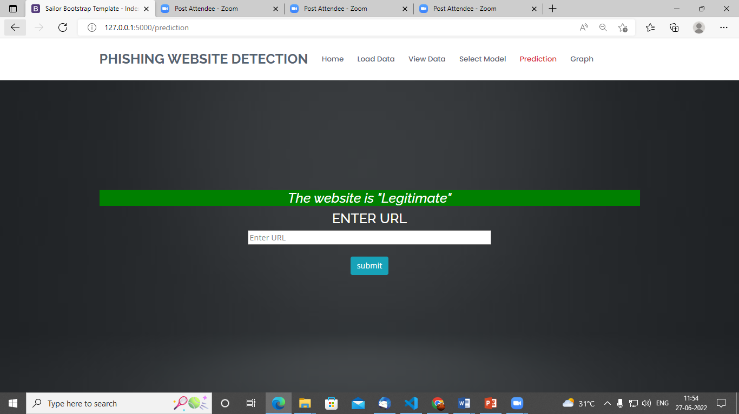
Prediction:
This page show the detection result that whether the website is a phishing website or legitimate.

Slide 49
CONCLUSION:
Phishing website detection using machine learning is a promising approach to combat the growing threat of online fraud. Machine learning algorithms can be trained to detect patterns in the behavior and characteristics of phishing websites, allowing them to identify and block suspicious sites before they can do harm. Recent studies have shown that machine learning algorithms can achieve high levels of accuracy in detecting phishing websites. These algorithms can analyze various features of a website, such as its URL structure, content, and user interface, to determine whether it is likely to be a phishing site. However, it is important to note that machine learning algorithms are not perfect and can sometimes produce false positives or false negatives. Additionally, phishing attackers are constantly evolving their tactics, so machine learning models must be continuously updated and refined to stay effective. Overall, phishing website detection using machine learning is a valuable tool in the fight against online fraud, but it should be used in conjunction with other security measures to provide the most comprehensive protection for users.

Slide 50
REFERENCES:
1. J. Shad and S. Sharma, “A Novel Machine Learning Approach to Detect Phishing Websites Jaypee Institute of Information Technology,” pp. 425–430, 2018.
2. Y. Sönmez, T. Tuncer, H. Gökal, and E. Avci, “Phishing web sites features classification based on extreme learning machine,” 6th Int. Symp. Digit. Forensic Secur. ISDFS 2018 - Proceeding, vol. 2018–Janua, pp. 1–5, 2018.
3. T. Peng, I. Harris, and Y. Sawa, “Detecting Phishing Attacks Using Natural Language Processing and Machine Learning,” Proc. - 12th IEEE Int. Conf. Semant. Comput. ICSC 2018, vol. 2018–Janua, pp. 300–301, 2018.
4. M. Karabatak and T. Mustafa, “Performance comparison of classifiers on reduced phishing website dataset,” 6th Int. Symp. Digit. Forensic Secur. ISDFS 2018 - Proceeding, vol. 2018–Janua, pp. 1–5, 2018.
5. S. Parekh, D. Parikh, S. Kotak, and P. S. Sankhe, “A New Method for Detection of Phishing Websites: URL Detection,” in 2018 Second International Conference on Inventive Communication and Computational Technologies (ICICCT), 2018, vol. 0, no. Icicct, pp. 949–952.

Slide 51
6. K. Shima et al., “Classification of URL bitstreams using bag of bytes,” in 2018 21st Conference on Innovation in Clouds, Internet and Networks and Workshops (ICIN), 2018, vol. 91, pp. 1–5.
7. A. Vazhayil, R. Vinayakumar, and K. Soman, “Comparative Study of the Detection of Malicious URLs Using Shallow and Deep Networks,” in 2018 9th International Conference on Computing, Communication and Networking Technologies, ICCCNT 2018, 2018, pp. 1– 6.
8. W. Fadheel, M. Abusharkh, and I. Abdel-Qader, “On Feature Selection for the Prediction of Phishing Websites,” 2017 IEEE 15th Intl Conf Dependable, Auton. Secur. Comput. 15th Intl Conf Pervasive Intell. Comput. 3rd Intl Conf Big Data Intell. Comput. Cyber Sci. Technol. Congr., pp. 871–876, 2017.
9. X. Zhang, Y. Zeng, X. Jin, Z. Yan, and G. Geng, “Boosting the Phishing Detection Performance by Semantic Analysis,” 2017.
10. L. MacHado and J. Gadge, “Phishing Sites Detection Based on C4.5 Decision Tree Algorithm,” in 2017 International Conference on Computing, Communication, Control and Automation, ICCUBEA 2017, 2018, pp. 1–5.

Slide 52


